Slide 1
Smart Students Attendance System
Work integrated learning project
Organization: ITIC Pty Ltd
Mentor: Ivan Bakhshayeshi
Intern: Meet Prajapati

Slide 2
Project description
Create a system that can track students attendance in an online class or in an examination.
Project deals with the problem of computer vision.
Requires tasks like detecting, transforming or modifying, and predicting the faces of students using deep neural network
The main objectives for building this system are to recognize students face and save the attendance record in a file for matching the student ID.

Slide 3
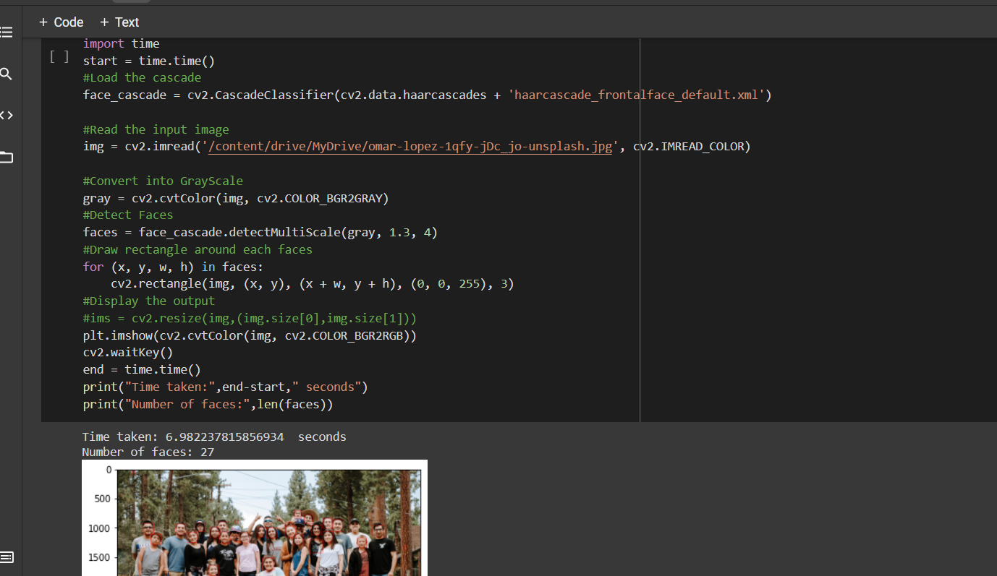
Exploring computer vision library
As suggested, I commenced project with exploring the computer vision library ‘OpenCv’.
Reading and manipulating image, detecting faces in an image

Slide 4
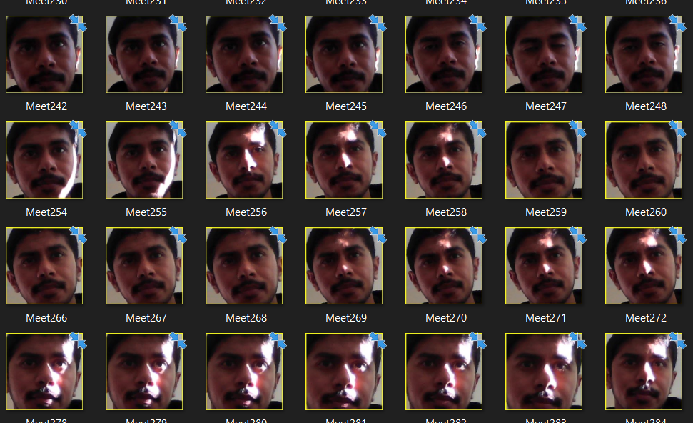
Creating a dataset
Using OpenCv library functionality detecting and capturing 300 images of subject.

Slide 5
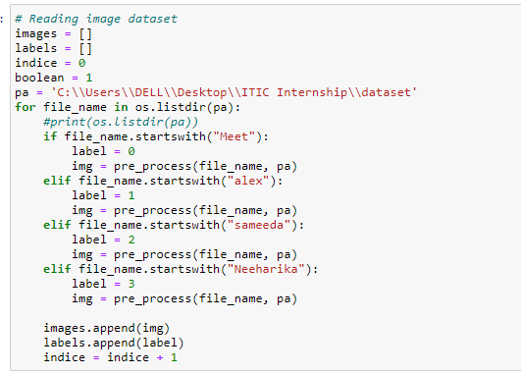
Reading and preprocessing dataset
Creating a function for preprocessing the dataset including resizing the images
Creating a loop which will read images of different formats from a single directory.
Creating lists of images and labels and read images from a single directory of a dataset.
The dataset contains images of other peers in internship.
There are 330 images in total

Slide 6
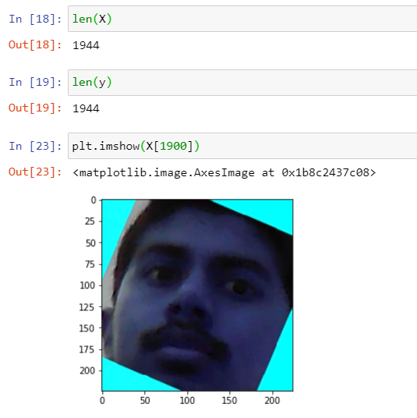
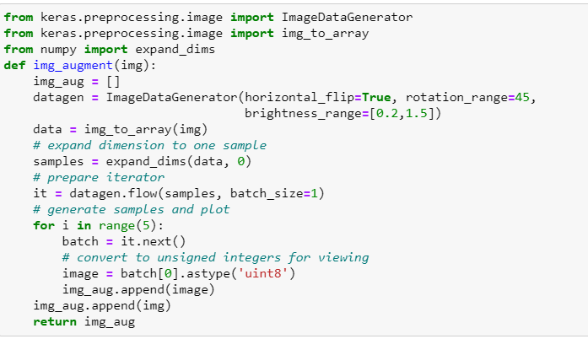
Data Augmentation technique

Slide 7
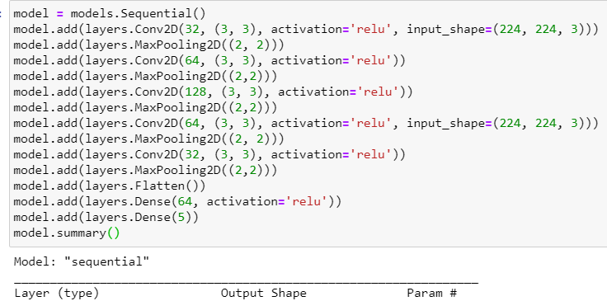
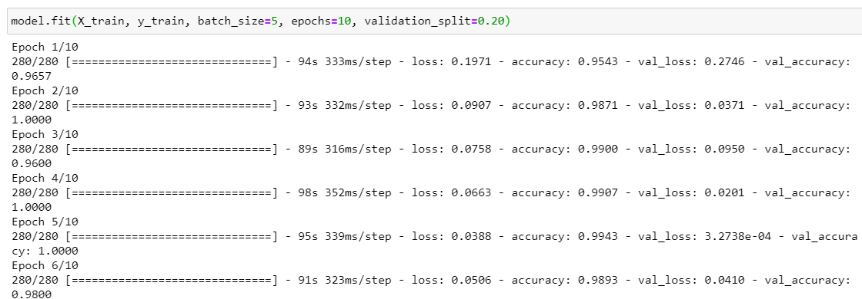
Convolutional neural networks model

Slide 8
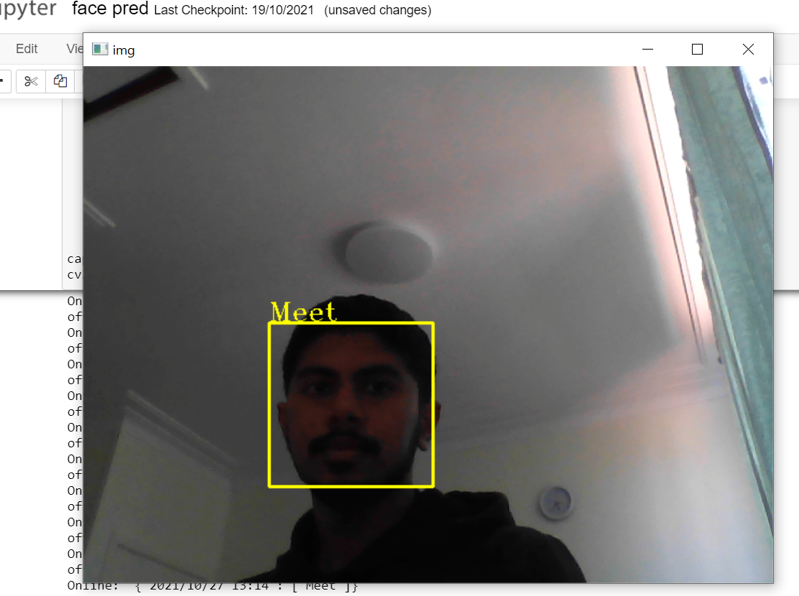
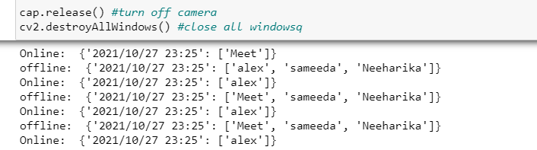
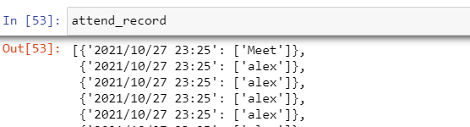
Predicting faces and recording attendance

Slide 9
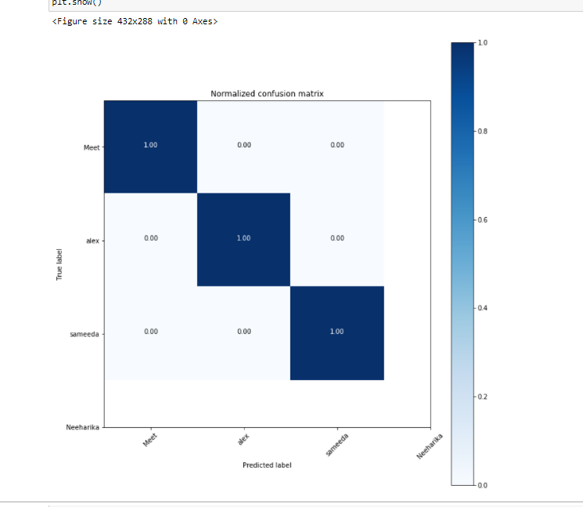
Plotting the results

Slide 10
Conclusion & Future plans
From the derived prediction results we can say that the model predicts some faces accurately and some does not.
For improving the predictions The more balanced dataset would be ideal.
Also, transfer learning can be used for already trained models and deploying them with certain features.
Future recommendations for the project would be to detect emotions of the faces and deploying the system into a web application.

Slide 11
References
L. Li, X. Mu, S. Li and H. Peng, "A Review of Face Recognition Technology," in IEEE Access, vol. 8, pp. 139110-139120, 2020, doi: 10.1109/ACCESS.2020.3011028.
Moolayil, J. J. (2020, May 23). A layman's guide to deep convolutional Neural Networks. Medium. Retrieved October 15, 2021, from https://towardsdatascience.com/a-laymans-guide-to-deep-convolutional-neural-networks-7e937628605f.
Dumane, G. (2020, December 11). Image augmentation using python, numpy, Opencv and Skimage. Medium. Retrieved October 12, 2021, from https://towardsdatascience.com/image-augmentation-using-python-numpy-opencv-and-skimage-ef027e9898da.

